Slide 1
Property List
Home
Post Property
Agents
Customer

Slide 2
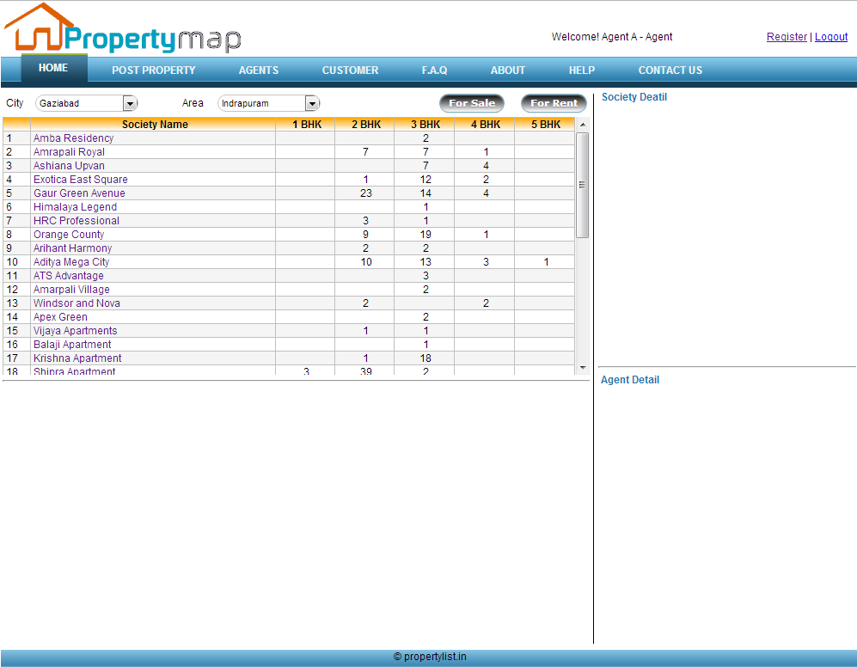

Slide 3
Home
Society Availability
Society Detail
Availability Detail
Map
Agent Detail

Slide 4
Post Property
Post Property
Logged in
no
Login
yes
Post

Slide 5
Agents
Agent
Logged In as Agent?
no
Login
yes
Availability
List with Assigned Clients
Post New Availability
Client List
Add New Client
Assign Property to Client
Edit Availability
Edit Client
Client- Assigned Availability List
Availability List Assigned To Client

Slide 6
Clients
Client
Enter Mobile No
Property List Assigned to Client
Property Detail
Society Location Map

Slide 7
DFD
Map
Detail
Images
Detail
Detail
Society/Project
Builder
Landmarks
Block
Apartment
Availability
Agent
Apartment Type
Owner
Agent Client
Price List
Detail
Details
Details
Detail
Images

